Slide 1
Image Analysis BMB 547 Jonathan Brewer

Slide 2
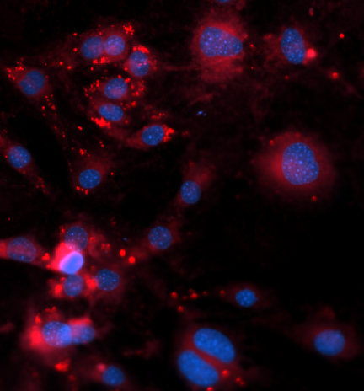
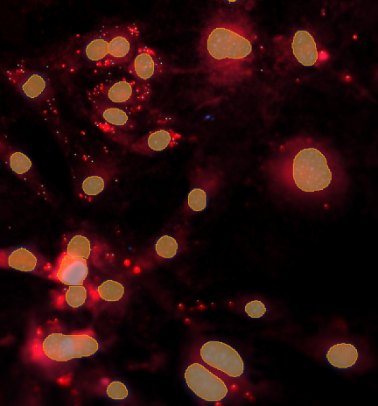
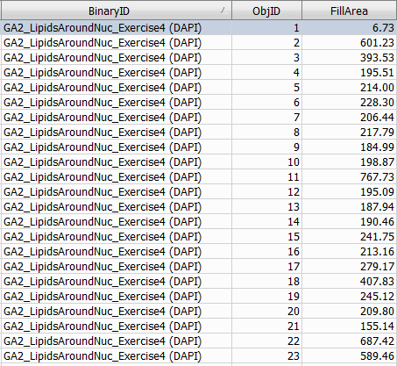
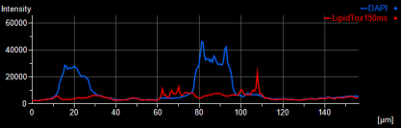
Why Image Analysis
As scientists acquire images to get DATA
Image
Regionalize and Measure
Data

Slide 3
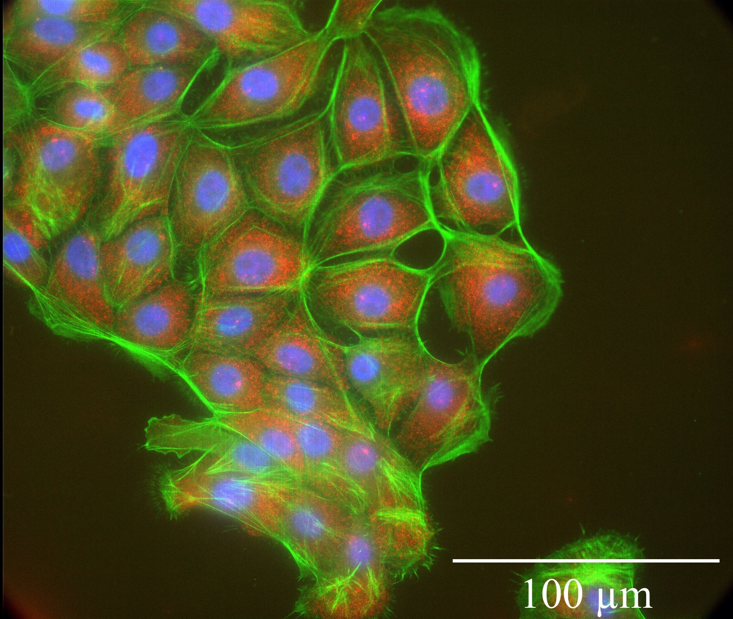
Spatial transcriptomics smFISH
Stochastic Optical Reconstruction Microscopy (STORM): resolution 20-40 nm: N/TERT-1 cells with CK14

Slide 4
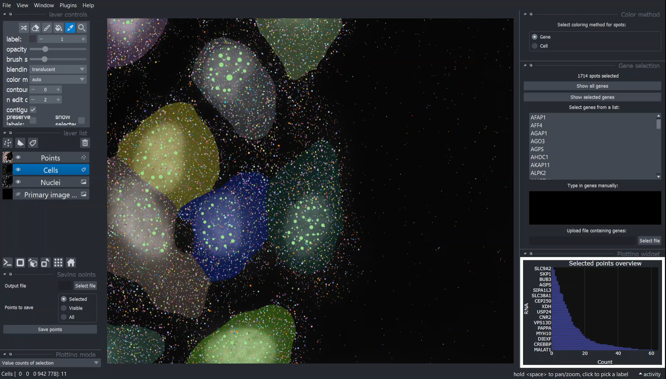
Spatial transcriptomics
Single cell selection and change plotting mode
Notes:
It is also possible to select single cells, which updates the plot.
This allows the user to change the plotting mode, where the fold change in gene expression is also available.
Although this visualizer is a robust tool for data exploration, it should be improved further to handle large data sets better.

Slide 5
Topics:
Basic properties of digital images (sampling, formats, size, depth, )
Image enhancement (how to make your image look better)
histograms, LUT, contrast enhancement
background subtraction
filter masks (smoothing and sharpening)
Working with image stacks
Colocalization
Image segmentation by thresholding
Deconvolution

Slide 6

Quantitative Imaging?
…what does that mean?
Art or Science?
Science means to measure something!
Numerical Results
Statistics!
Computers become useful...

Slide 7
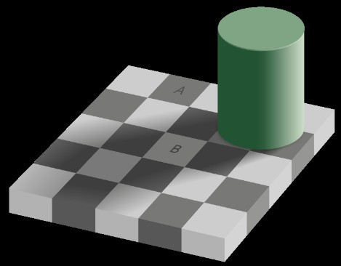
Which is brighter A or B?
Still sure you can interpret intensities in greyscale images with your eyes?

Slide 8

Which colours can you see???

Slide 9


“Colour Merge” images could ruin your life
You see spirals, of pink, orange, green and blue?
Actually,
the green and blue...
are the same color!
Moral of the story:
Don’t Trust Your Eyes!

Slide 10





What is Image Analysis / Quantification?
Minimum: 50
Maximum : 255
Mean: 94.5
Std.Dev.: 93.2 Area: 10x14
Pixels: 140
Pix <255: 42
Object: Body: Head: Legs: Arms:
Stick man 1
1
2 (1 lifted)
2 (2 lifted)
255 | 255 | 255 | 255 | 255 | 255 | 255 | 255 | 255 | 255
255 | 255 | 255 | 255 | 50 | 50 | 50 | 50 | 255 | 255
255 | 255 | 255 | 50 | 50 | 50 | 50 | 50 | 255 | 255
255 | 255 | 255 | 50 | 50 | 50 | 50 | 50 | 255 | 255
255 | 255 | 255 | 72 | 50 | 50 | 50 | 50 | 255 | 255
255 | 255 | 255 | 255 | 50 | 50 | 50 | 255 | 255 | 255
255 | 50 | 50 | 50 | 50 | 50 | 50 | 50 | 50 | 255
255 | 255 | 255 | 255 | 255 | 50 | 255 | 255 | 255 | 255
255 | 255 | 255 | 255 | 50 | 255 | 255 | 255 | 255 | 255
255 | 255 | 255 | 255 | 50 | 50 | 50 | 50 | 51 | 168
255 | 255 | 255 | 255 | 50 | 255 | 255 | 255 | 255 | 255
255 | 255 | 255 | 50 | 255 | 255 | 255 | 255 | 255 | 255
255 | 255 | 255 | 50 | 255 | 255 | 255 | 255 | 255 | 255
255 | 255 | 50 | 255 | 255 | 255 | 255 | 255 | 255 | 255
Walking left to right…
= Image Analysis/ Measurement
= Interpretation of Analysis Result

Slide 11
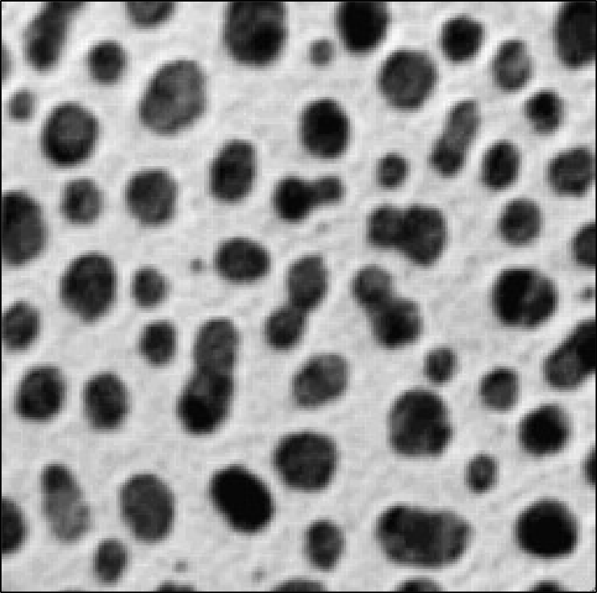

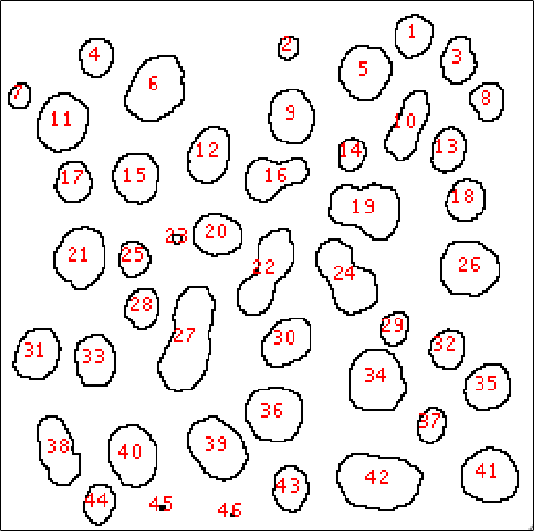
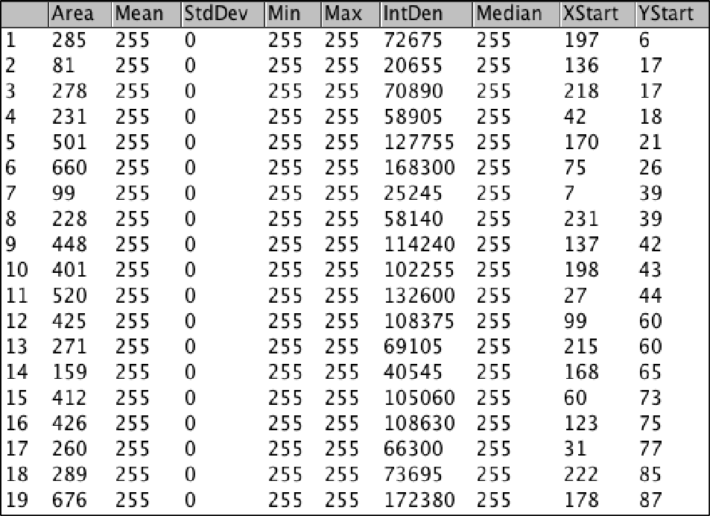
Image = Information
Images contain information!!!
Quantify / Measure / Analyse
Meta data (what, where, when, how)
Noise / Background

Slide 12



Photographer or Spectroscopist?
 | 0 | 0 | 1 | 0 | 0
 | 0 | 1 | 0 | 1 | 0
 | 0 | 0 | 1 | 0 | 0
 | 0 | 0 | 1 | 0 | 0
 | 1 | 1 | 1 | 1 | 1
 |  |  | 1 | 0 | 0
 |  |  | 0 | 1 | 0
 |  |  | 0 | 0 | 1
This
Is simply a way to “Visualise”
 | 0 | 0
 | 0 | 1
 | 1 | 0
 | x
y
This

Slide 13






What is a (Digital) Image anyway..?
it’s a digital “representation” of reality!
it’s an artifact that contains less info than the object!
it’s just numbers! NOT analogue art!
The Image of a point is NOT a point!!! (Point Spread Function – PSF)
A digital image of ???
• • • • •
• • • • •
• • • • •
• • • • •
• • • • •
• • • • •
• • • • •
• • • • •
Image Analysis (Brain or Computer)
=
A stick man? How do I know?
How can computer know
- algorithm?
y
x

Slide 14
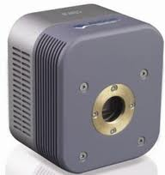
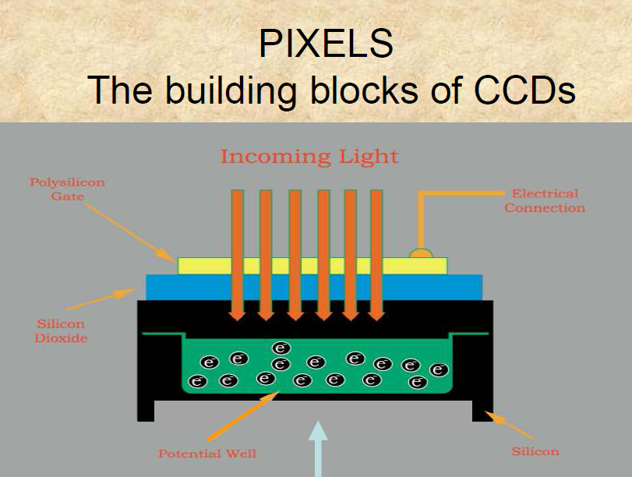
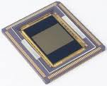
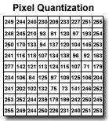
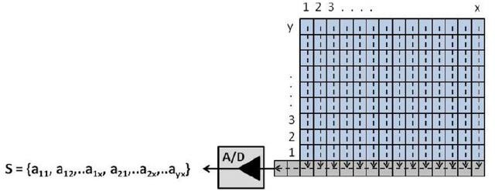
The digital image: pixel size
Photons induce transport of electrons.
Transport of electrons generates voltage.
Generated voltage is proportional to number of incoming photons.

Slide 15
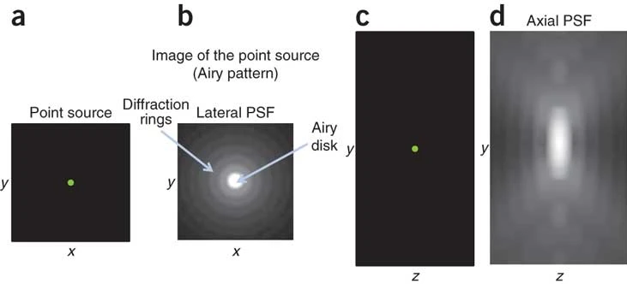
The point spread function (PSF)
The point spread function (PSF) describes the response of a microscope to a point source or point object.

Slide 16

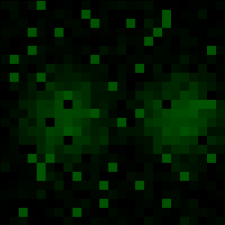
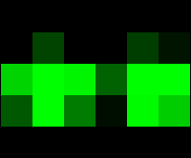



Pixel Size / Image Resolution
“Correct” image size? 64x64, 512x512, 2048x2048, …
Nyquist – Shannon sampling theory: Proper spatial sampling
2.3 – 3 times smaller than optical resolution (x, y, AND z)
Adjust zoom, binning, and image size (no of pixels)
under sampled
over sampled
correct sampling
1 Airy unit

Slide 17



Nyquist sampling criterion
General form
Digital sampling frequency > analogue frequency x 2
Spatial representation
Image pixel size x 2.3 = smallest resolvable distance
Microscopy
Image pixel size x 2.3 = optical resolution (d)

Slide 18
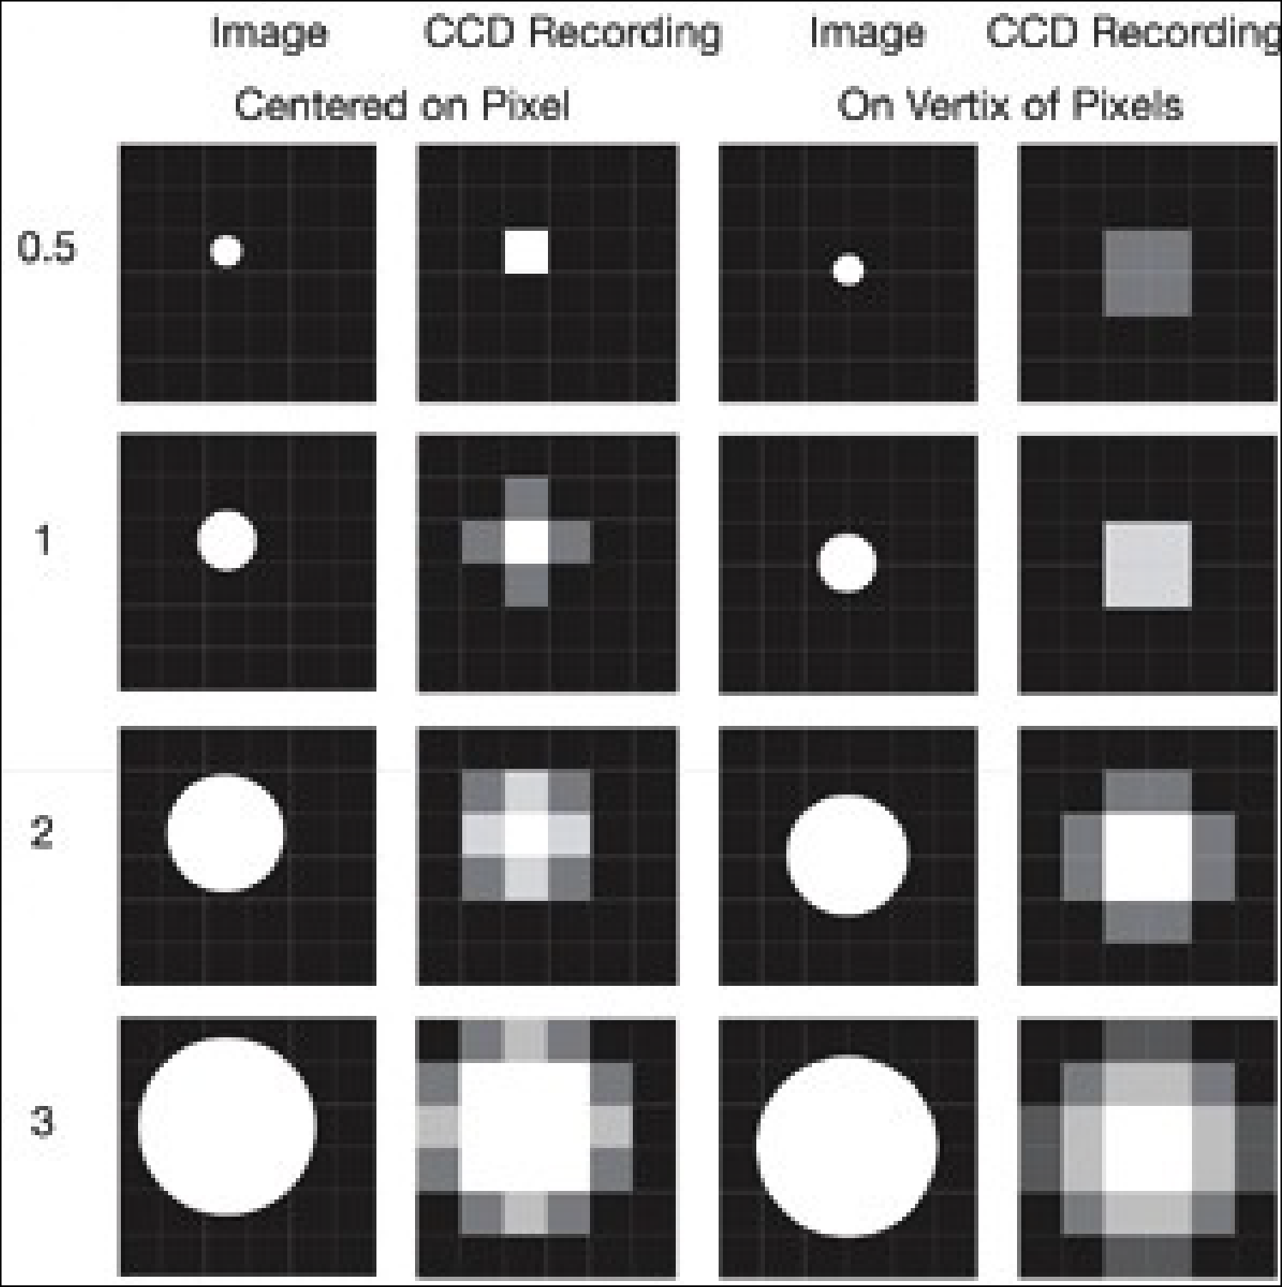


Aliasing problems...
Pixel size relative to projected image
Image of object varies, depending on where it falls on detector
-
Especially for small objects close to pixel size

Slide 19

Pixel size / Spatial Calibration
Pixel size is determined by the microscope system!
CCD photodiode “pixel” size - Magnification X
Point scanner settings – zoom and image size
Field of View Size - No. of Samples or “pixels”
It might be changed / lost during processing
It is stored in the “Meta Data”

Slide 20
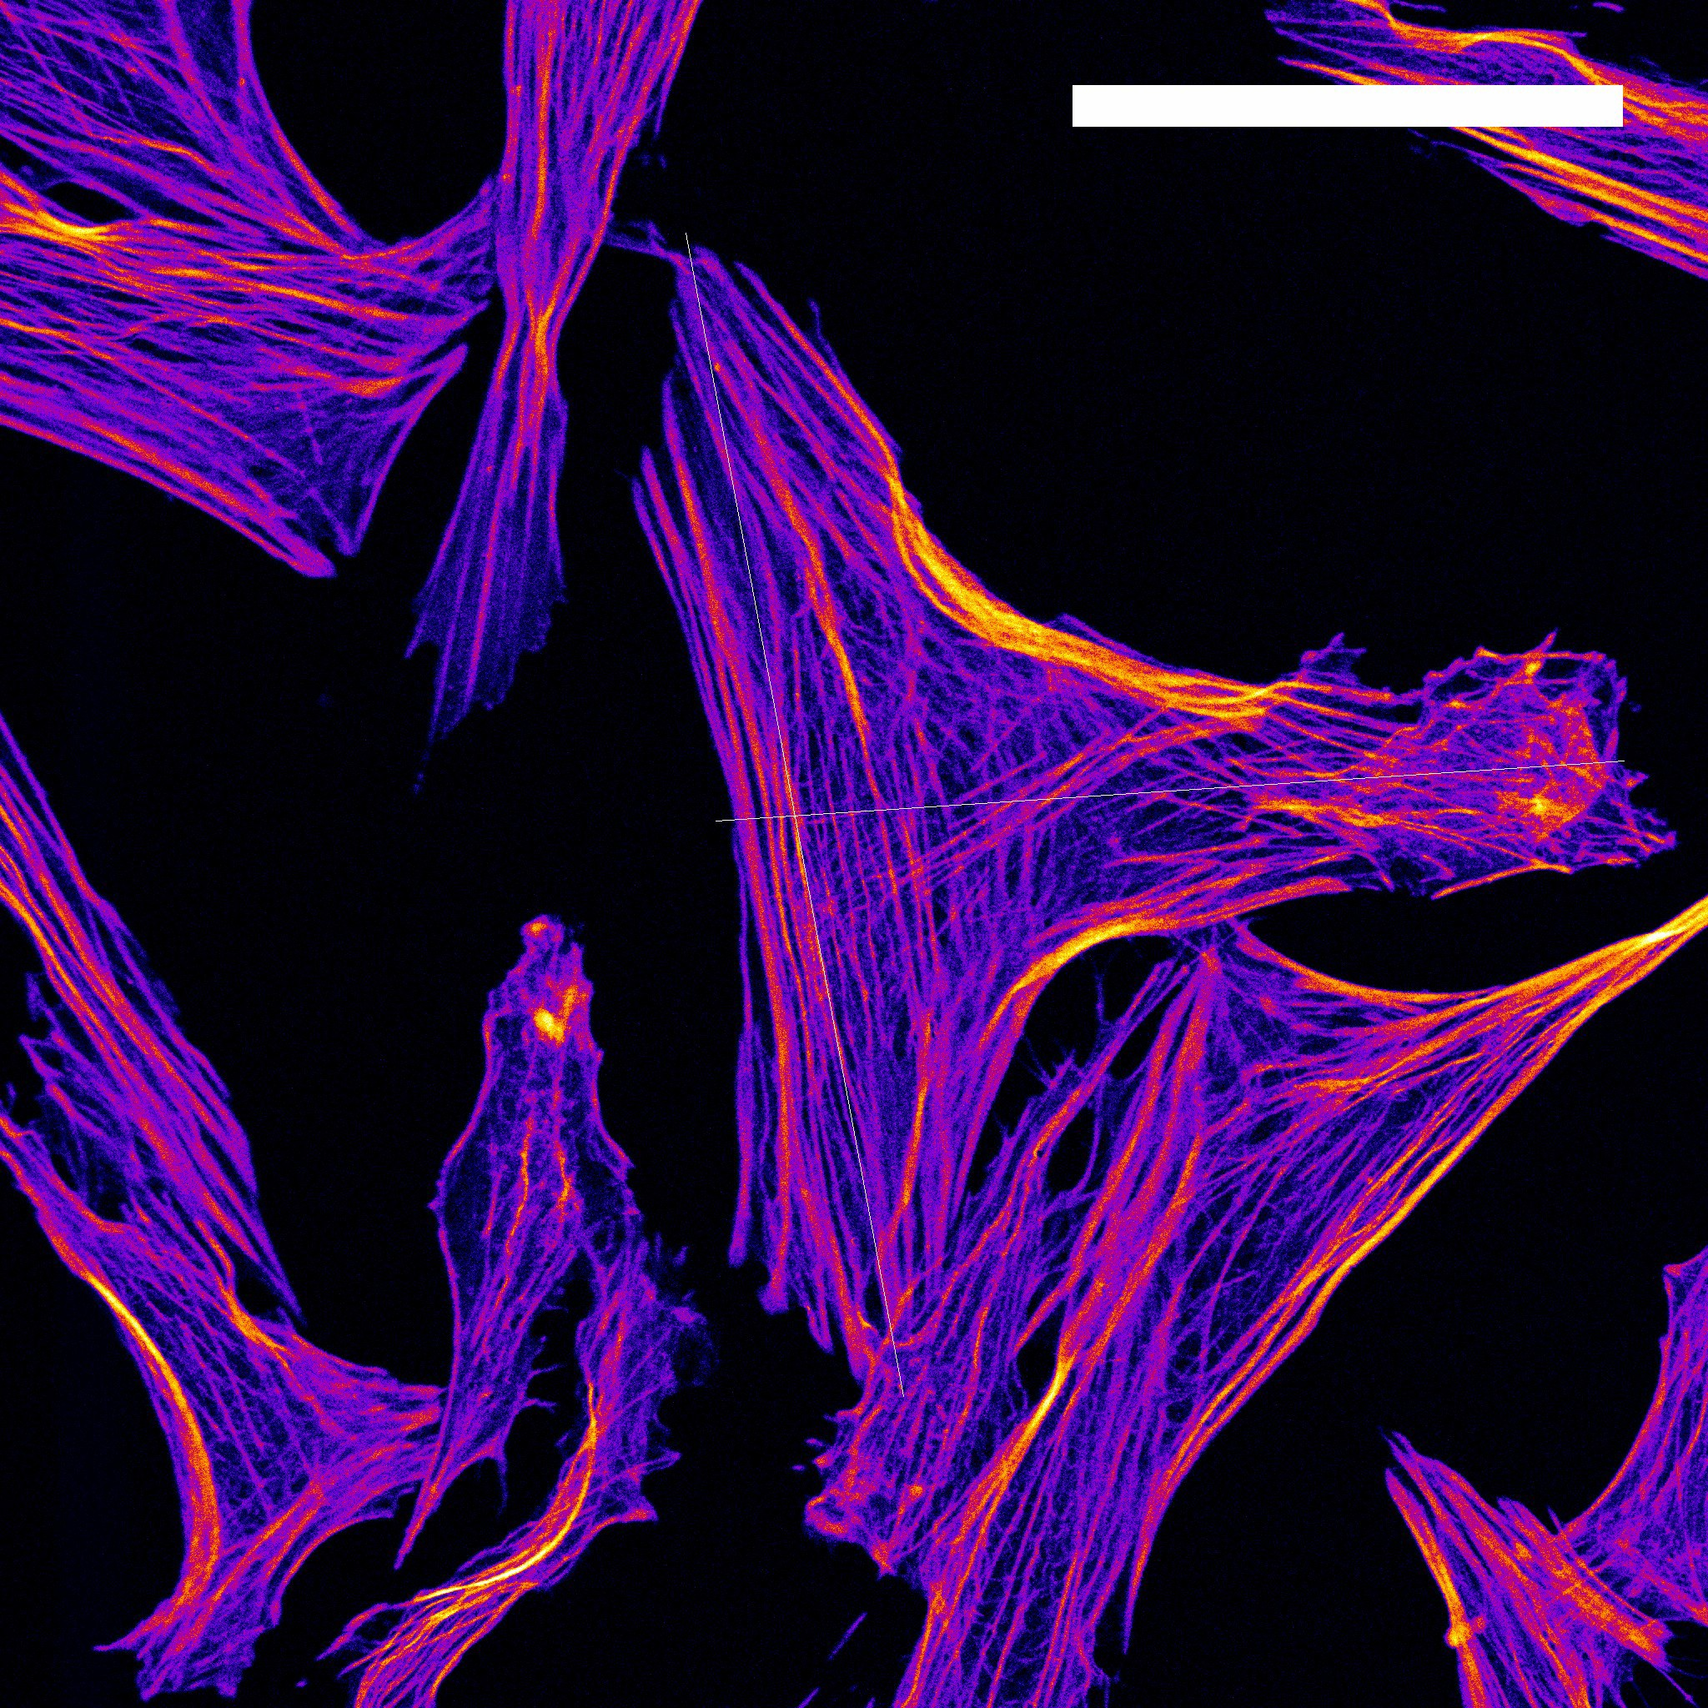
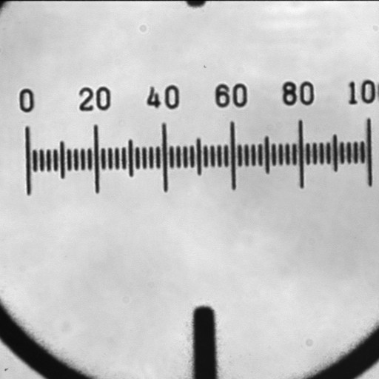
Pixel Size / Spatial Calibration
?
?
?
0.9 µm
?
?

Slide 21
The digital image: Bit Depth
Photons induce transport of electrons.
Transport of electrons generates voltage.
Generated voltage is proportional to number of incoming photons.

Slide 22





“Intensity” Digitisation
Bit Depth
Measured intensity by detector
“Bucket” holds
0-9 electrons
5 electrons counted
digitization
Bit depth: 10 (0 to 9)levels
Level 5 selected for
RAW data “image”
Corresponding level in image

Slide 23






“Intensity” Digitisation
Bit Depth
“digital“ intensity
“real” analogue intensities
“digital“ intensity resolution: 20
resolution: 10
9
19
0
0

Slide 24
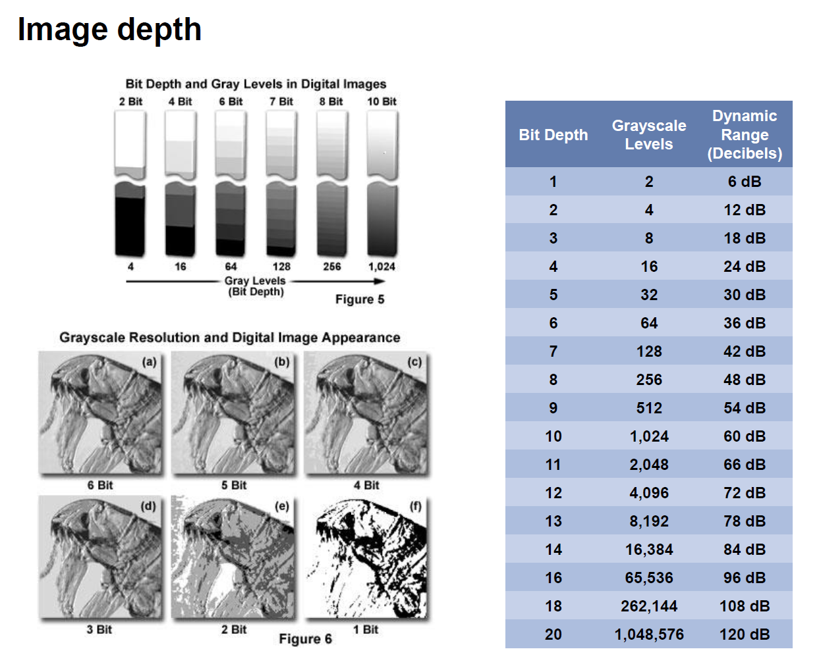

Slide 25
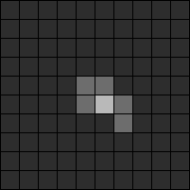
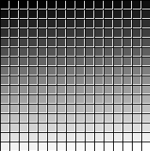
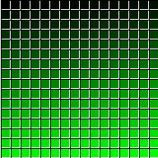
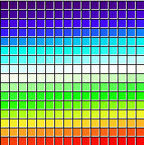
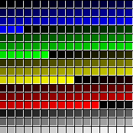

Brief explanation of digital imaging
$$8 bit=2^{8}=256$$
Black, white, 254 shades of gray
Binary | Hex | Decimal | Color
00000000 | 00 | 0 | Black
11111111 | FF | 255 | White
10111001 | B9 | 185 | Gray
Color-table dependent!
Gray LUT
Green LUT
Thermal LUT
5 ramps LUT

Slide 26
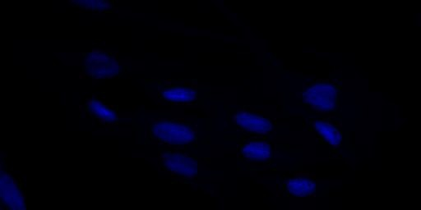

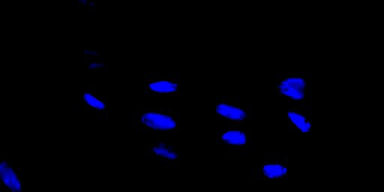


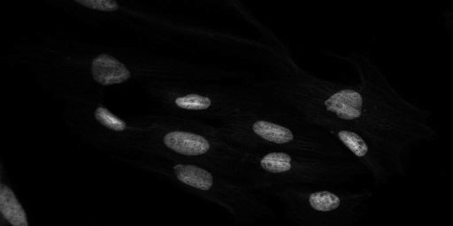



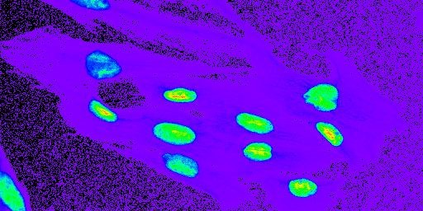

“original” - linear blue
altered brightness/contrast
data changed/lost!
Grayscale - linear
Rainbow lookup table
better see and also compare different
intensity levels

Slide 27
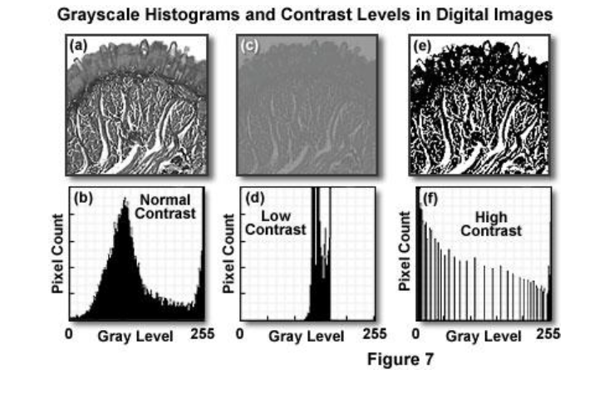
The histogram

Slide 28
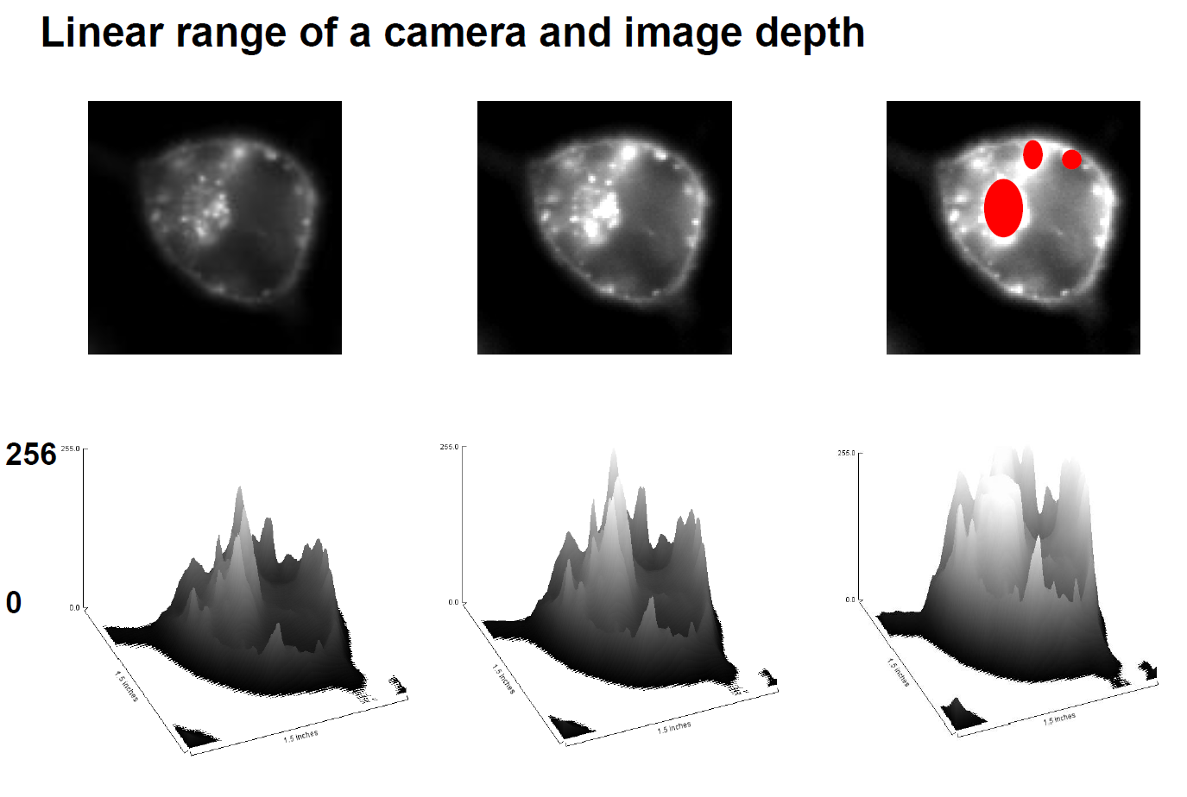
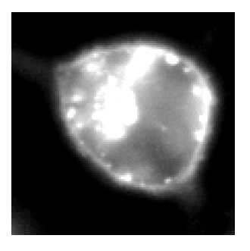
Intensity / Exposure / Saturation

Slide 29




Intensity / Exposure / Saturation
Do NOT over expose / saturate your image!!!
Why not? → Lost Information!
Use “Look Up Tables (LUT) / palettes to check the saturation
Bye Bye Data!
in range
255
pixel intensity
clipped
overexposed saturated
0
x

Slide 30







Image Intensity Histograms - Use them!
Lost Info! Clipped!
OK!
log no. of pixels
0
intensity
255
0
255
In Histograms: easily see problems for image quantification!
?
0 30
255
30 = 0 ???!!!

Slide 31
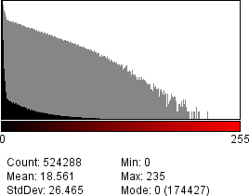
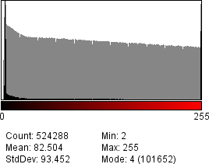


Intensity Histogram
Fluorescence Microscopy
OK
not OK - why?

Slide 32
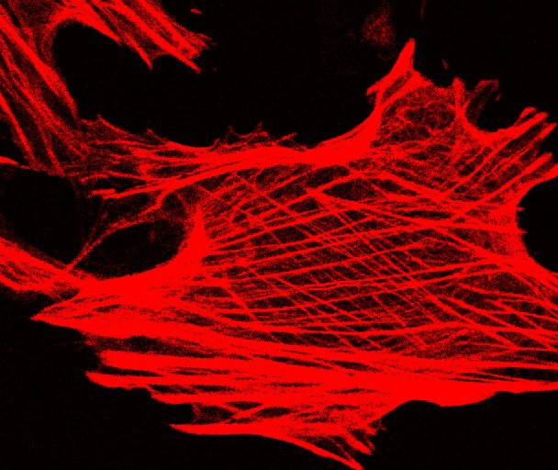
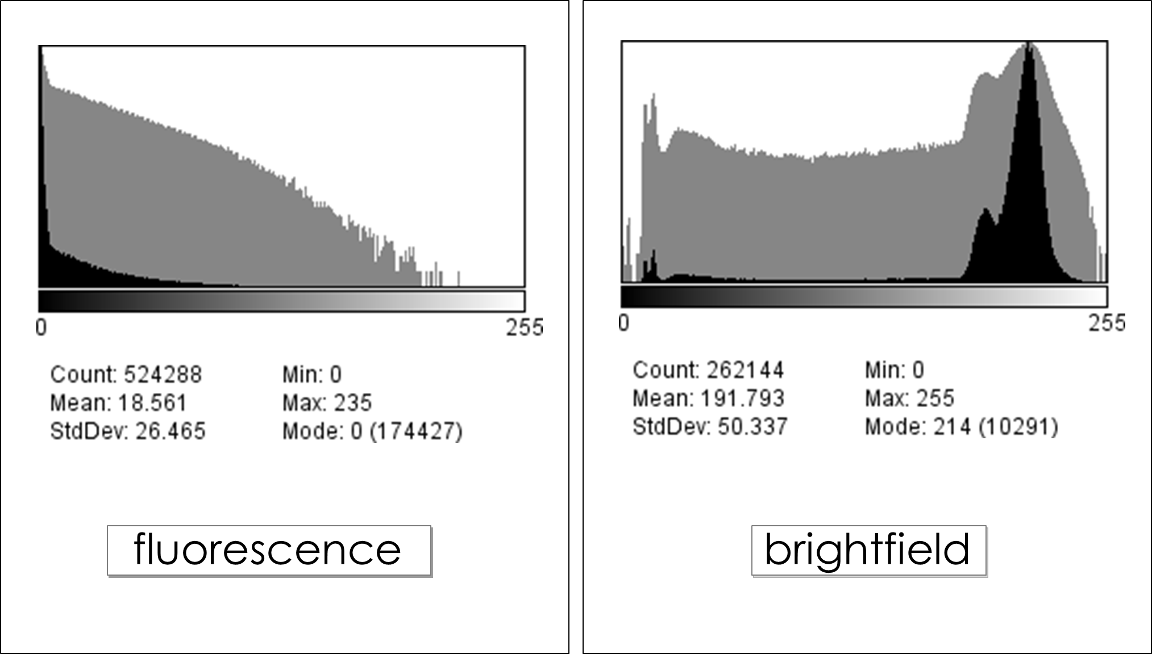
Intensity Histogram

Slide 33

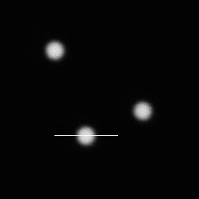
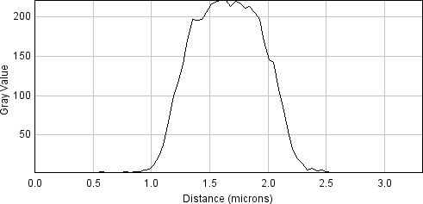



Line Profile
for measurements
0.9 µm
50% of
max. intensity
FWHM
FWHM= “Full Width at Half Maximum”

Slide 34
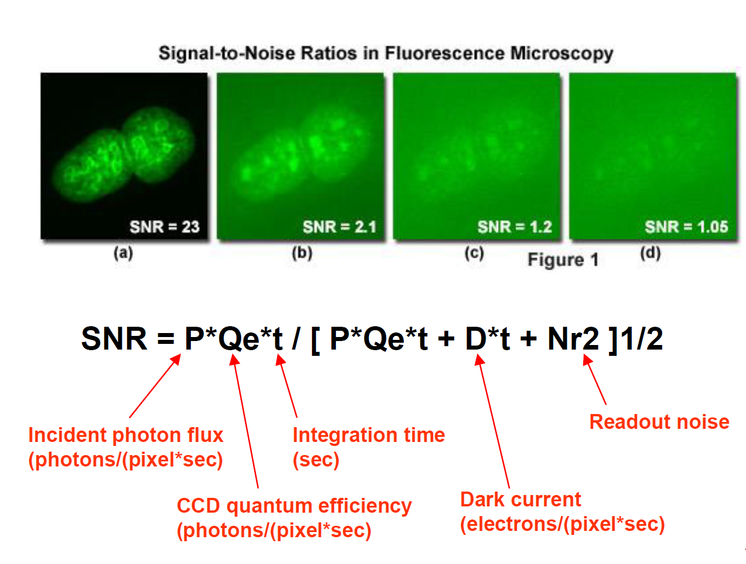
Image quality

Slide 35
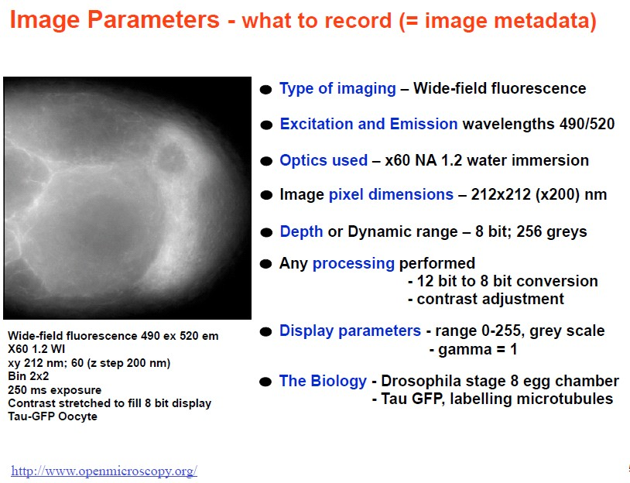

Slide 36
Image plus meta data

Slide 37

ImageJ using FIJI

Slide 38
What is Fiji and ImageJ
Open source https://imagej.net/downloads
Advantages and disadvantages
Free
Fairly easy to use
Programmable
Thousands of all ready developed ‘plugins’
Google probably know what you are looking for.
Poorly documented
Work/click intensive
The different plugins can be very inconsistent
Currently, if one works with microscopy, ImageJ is unavoidable!

Slide 39


File - Open Samples - Embryos
Spatial Scaling:
Can you measure the length and area of objects?
→ See Fiji Tutorial - SpatialCalibration (search Wiki)
Analyze - Set Scale, Analyze-Tools-Scale Bar
Line and ROI selection - ctrl M (cmd M)
Rectangle, Oval, Polygon, Freehand, Angle, Point, Wand.
Analyze - Set Measurements (Results – Edit - summarize)

Slide 40

File - Open Samples - Neuron
Intensity clipping/ saturation and offset:
Bit Depth – change from 16 to 8. What happens to the numbers?
Brightness/Contrast: Image-Adjust-Brightness/Contrast. Realize: you can loose data using “Apply”!
Intensity Histograms: log scale for fluorescence

Slide 41
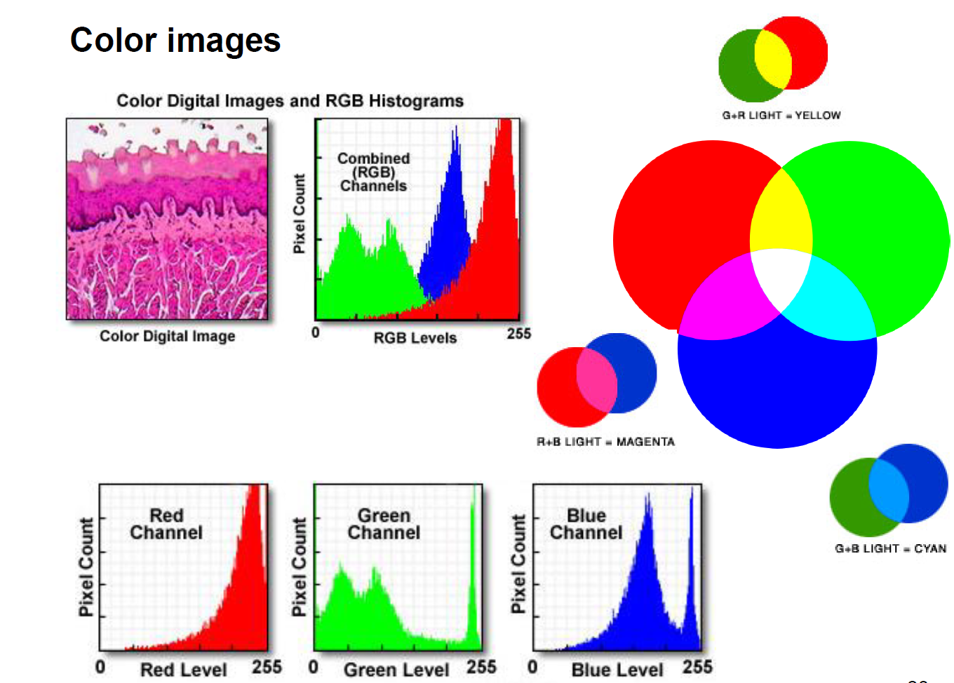

Slide 42
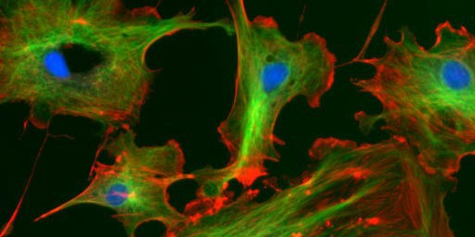


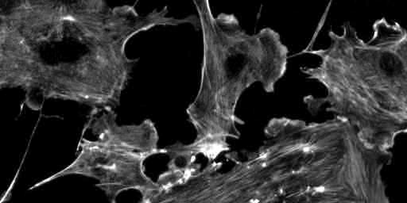




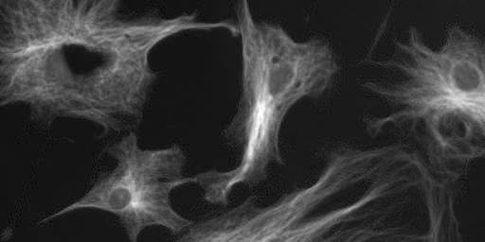

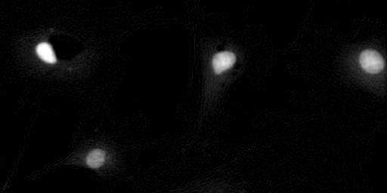

RGB Color Space
Why RGB? ... because we have red, green and blue sensitive photo receptors in our eyes!
19
Each “colour” is really just single greyscale numbers!
0
R G B

Slide 43

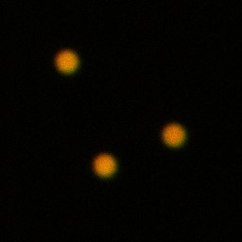
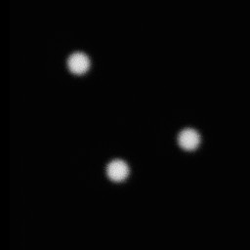
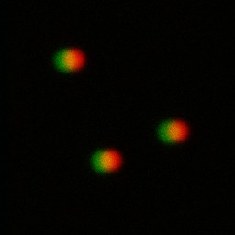










Scatterplot / 2D Histogram/ Colocalization Analysis
original R+G
R shifted +10 pix
R shifted +20 pix
Green intensity
Green intensity
Green intensity
Red intensity
Red intensity
Red intensity
Find a way to visualise what you actually want to see:
Here, we don’t care WHERE the beads are; We care if they are in the same place or not!

Slide 44

Pearson’s Image Correlation Coefficient (Manders et al., 1993)
Correlation between images, r ranges from -1 to +1
+1 means full correlation (images are the same) 0 means no correlation (random)
-1 means full anti correlation (no red where there is green)

Slide 45
Pearson’s Image Correlation Coefficient
In English…per pixel and summed for the whole image:
r = +1
r = -1
r = 0
r > 0

Slide 46
Pearson’s Image Correlation Coefficient is…
Insensitive to diff. intensity of the 2 images. Insensitive to intensity offset.
If red is 1/2 as bright as green…
Still can get r = 1
… so Pearsons r is is robust for biological imaging…

Slide 47


Getting to know “Fiji” better – Fiji is just ImageJ http://pacific.mpi-cbg.de
File - Open Samples - Neuron
RGB colour space:
Colour channels – Image-Colour-Channels Tool, Split channels etc.
LookUp Tables/Paletts: Image - Lookup tables, or LUT toolbar icon
Histogramm: Analyze-Histogram
Intensity Scale: Analyze – Tools - Calibration bar

Slide 48


Working with multi dimensional images
More than one frame, time point or channel
Ortho view, montage and other ways of looking at >2D image
3D volume
File - Open Samples - confocal-series.tif
Make a montage: Stk→ Make montage

Slide 49




Image processing masks and filters
Introduction
Neighbourhood
Operation on neighbourhood
Spatial filters
Mean and Median filter
Edge detection

Slide 50



A. Introduction
“Transformation or set of transformations where a new image is obtained by neighbourhood operations.”
The Intensity of a pixel in the new image depends on the intensity values of “neighbour pixels”
Neighbourhood (or kernel): pixels that matter

Slide 51
3 x 3

Slide 52

5 x 5

Slide 53



B: Filtering - the mean filter
Simplest filter: The value of a pixel is replaced by the intensity mean of the neighbourhood pixels.
3x3 example:

Slide 54


The mean filter
The mean filter is a linear filter!
“The new pixel value depends on a linear combination of neighbourhood pixel values”
(The order of several linear filters in sequence does not matter)

Slide 55


Slide 56



The mean filter
Main property: low-pass filter (smooths small objects)
kernel size influence
number of successive applications
+ simplest filter – fast
+ it’s a linear filter
+ averages noise, does not eliminate it
+ works against Gaussian and Poisson noise
blurs images - small details are lost (low pass filter)
smoothes edges dramatically
fails for salt & pepper noise

Slide 57

Linear filtering - Properties
Applying a linear filter to an image is the same as: applying it to all parts, then summing the results.
When applying a succession of linear filters: the order filters are applied in does not matter.
Mathematical framework underlying it: Convolution.
We can also reverse the process : Deconvolution

Slide 58


The Gaussian filter
Gaussian Curve - Bell Shaped function
smooths Poisson noise
linear Filter
makes more mathematical sense than mean filter?
...properly spatially sampled image, looks like PSF
can vary the sigma value: number of pixels
varying degree of blur.

Slide 59



The median filter
The value of a pixel is replaced by the median of the pixel intensity in neighbour pixels
Take neighbourhood (e.g. 3x3)
Sort it
Take median
5
86
88
108
112
137
211
233
235
5 112 86
235 88 211
137 233 108
112

Slide 60





The median filter
noise elimination
Original:
Median filtered:
5 | 9 | 6 | 6 | 9 | 5 | 9
9 | 5 | 9 | 7 | 8 | 7 | 9
8 | 9 | 8 | 6 | 7 | 9 | 9
9 | 9 | 7 | 200 | 9 | 6 | 9
6 | 5 | 8 | 6 | 9 | 6 | 7
9 | 7 | 9 | 9 | 8 | 6 | 7
7 | 9 | 5 | 6 | 7 | 6 | 6
0 | 5 | 6 | 6 | 6 | 7 | 0
5 | 8 | 7 | 7 | 7 | 9 | 7
8 | 9 | 8 | 8 | 7 | 9 | 7
6 | 8 | 8 | 8 | 7 | 9 | 6
6 | 8 | 8 | 9 | 8 | 7 | 6
6 | 7 | 7 | 8 | 6 | 7 | 6
0 | 7 | 6 | 6 | 6 | 6 | 0
The outlier value has been completely removed from the dataset
outlier

Slide 61


The median filter
+ Typically good for “Salt & pepper” noise removal
+ Eliminates noise
+ Edge-preserving
-Slower than mean (not such a problem anymore... computers are fast)
- NOT linear

Slide 62


Slide 63


Slide 64

Simple Image Filtering
File - Open Samples – Neuron
Convolve a simple binary image
Process – Filters – Convolve (play with different kernels)
(2) Noisy sample image
Mean and Median Filter (change pixel number, kernel size)

Slide 65



What is “Image Segmentation”?
“Greyscale” image
Foreground background

Slide 66


What is “Image Segmentation”?
“Scalar Intensity” image
“Binary” image

Slide 67
What is “Image Segmentation”?
1 | 65 | 13 | 55 | 2
2 | 3 | 34 | 2 | 1
4 | 0 | 31 | 1 | 2
1 | 33 | 3 | 54 | 3
56 | 3 | 2 | 1 | 34
“Scalar Intensity” image
0 | 1 | 1 | 1 | 0
0 | 0 | 1 | 0 | 0
0 | 0 | 1 | 0 | 0
0 | 1 | 0 | 1 | 0
1 | 0 | 0 | 0 | 1
“Binary” image

Slide 68


What is “Image Segmentation”?
“Scalar Intensity” image
Labeled objects

Slide 69




What is “Image Segmentation”?
High Information Content 65536 pixels, 0-255 value
Lower Information Content, but easier to interpret
biological meaning…
45 “objects” with properties: size, shape, intensity etc.

Slide 70


“Thresholding” (Intensity Histogram Split)
Clear difference between foreground and background?
Image not very noisy?
Choose an intermediate grey value = “threshold”
Determines foreground and background.

Slide 71



“Thresholding” (Intensity Histogram Split)
How to choose the grey level for thresholding?
Look at pixel intensity histogram of whole image…
Is there an obvious place?

Slide 72
“Thresholding” (Intensity Histogram Split)
“Greyscale” image
Create foreground background using: auto threshold → otsu

Slide 73




Computed Global Threshold Objective - Reproducible
ImageJ - Image - Adjust - Threshold - Auto (=Make Binary):
Initial guess of Threshold, T
Compute mean pixel intensity of
background and foreground
Tnew = 0.5 x (mean of foregrnd
+ mean of bkgrnd)
Iterate until Tnew no longer
changes.
Note:
Manual threshold set?
Make Binary uses that dumb threshold!

Slide 74

Practical Session 2c
Simple Image Segmentation
File - Open Samples – Blobs (inverse)
Thesholds
Image - Adjust - Auto Threshold and Auto Local Threshold
Many more methods, and “local” method

Slide 75

Deconvolution

Slide 76
Image formation – convolution of signal
Object
Acquired image
x
Confocal PSF
Convolution + noise
Notes:
Widefield

Slide 77
Deconvolution
Object
?
Acquired image
x
Confocal PSF
Convolution + noise
Notes:
Widefield

Slide 78
Convolution←→Deconvolution
Point Spread Function (PSF)
Restore object based on knowledge about PSF

Slide 79

Deconvolution of WF image
Deconvolution reveals structure hidden caused by imaging acquisition

Slide 80
Topics:
ImageJ / FIJI
Basic properties of digital images (sampling, formats, size, depth, )
Image enhancement (how to make your image look better)
histograms, LUT, contrast enhancement
background subtraction
filter masks (smoothing and sharpening)
Working with image stacks
Colocalization
Image segmentation by thresholding
Deconvolution

